Slide 1
Natural Disasters: Statistics and Earthquake Shockwaves Prediction

Slide 2
PREPARED BY:
ID | Name
20170155 | Abdelaziz Mohsen Abdelaziz
20170275 | Marwan Ahmed Abdelmoneim
20170228 | Mohamed Khaled Khedr
20150131 | Seifeldin Mohamed Gamal
20170340 | Youssef Hassan Elsayed
UNDER SUPERVISION OF:
Associate Professor NEAMAT EL-TAZI
T.A. HODA TAWAKL

Slide 3
Introduction

Slide 4
Problem Description
Earthquakes and their impact.
Earthquake Prediction vs Earthquake Forecasting

Slide 5
Solution
People need to have more knowledge about natural disasters.
We decided to help people achieve that goal with our skills.

Slide 6
Overall Description

Slide 7
Objectives
Analyze natural disasters datasets.
Use machine learning models to predict earthquake aspects.
Establish a running web application that combines both of these features.
Provide interactive map that helps users find what they are looking for faster.

Slide 8
Challenges
Dealing with many different datasets and analyzing them all at the same time.
Exploring the right path for earthquake prediction models.
Finding the right way to build our database and connecting it properly to our system.
Transforming all the static design components into a React.js application.
User authentication process.

Slide 9
Limitations
Available API can only provide maximum of 20k records.
Actual earthquake happening prediction is impossible to be done and we can only predict the earthquakes other attributes and not the exact time.
Browsers cannot handle rendering more than 15k markers on the map without performance drawbacks.

Slide 10
Design Strategy

Slide 11
Business Goals
Provide pre-made plots and concluded statistical information about disasters for different users.
Provide a prediction of the magnitude of an upcoming earthquake.

Slide 12
Stakeholders
Geology geeks.
Researchers.
Governments.

Slide 13
General Tasks
Show graphs about disasters.
Interact with the map to see the history of disasters.
Show the result of our prediction.

Slide 14
Technological Constraints
Should browse from PC.
Should have an internet connection.

Slide 15
System Design

Slide 16
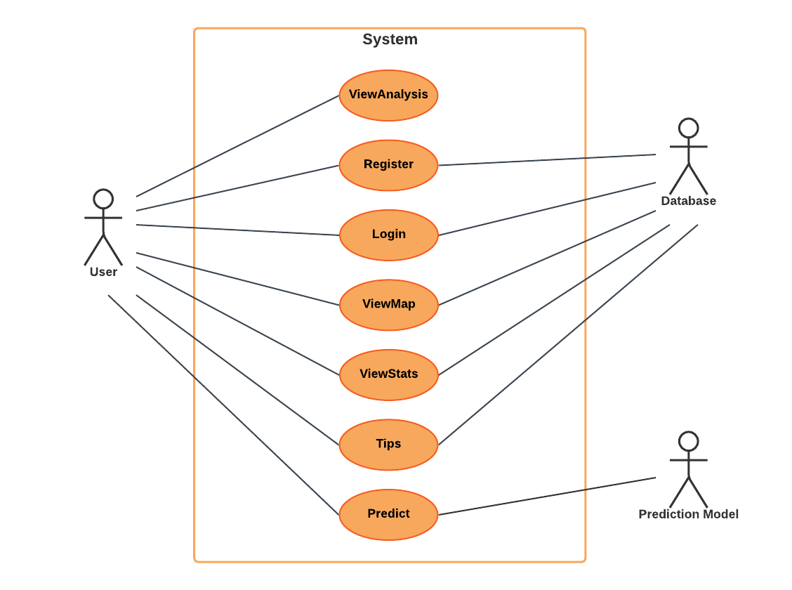
Use-Case Diagram

Slide 17
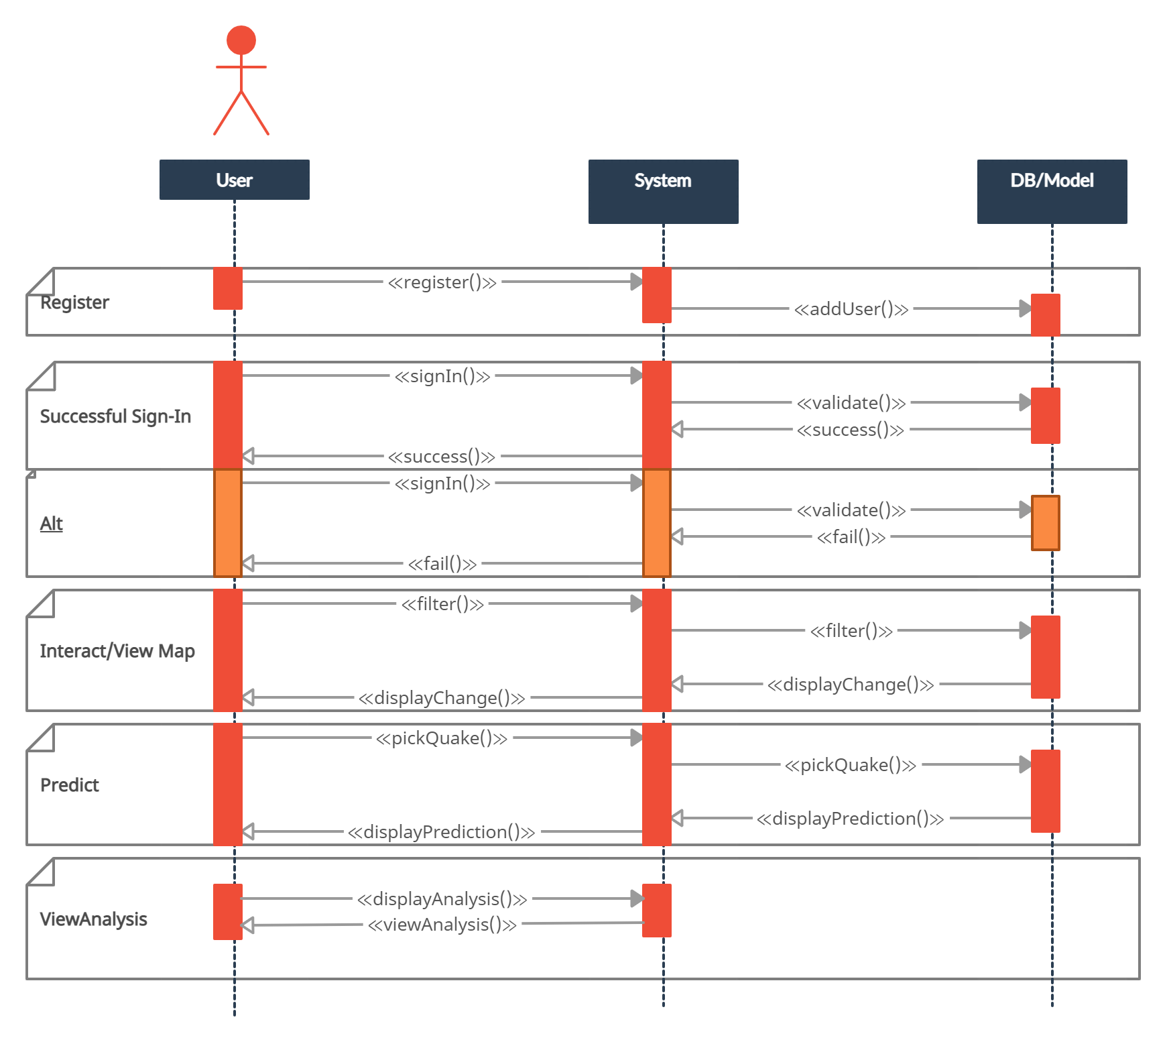
Sequence Diagram

Slide 18
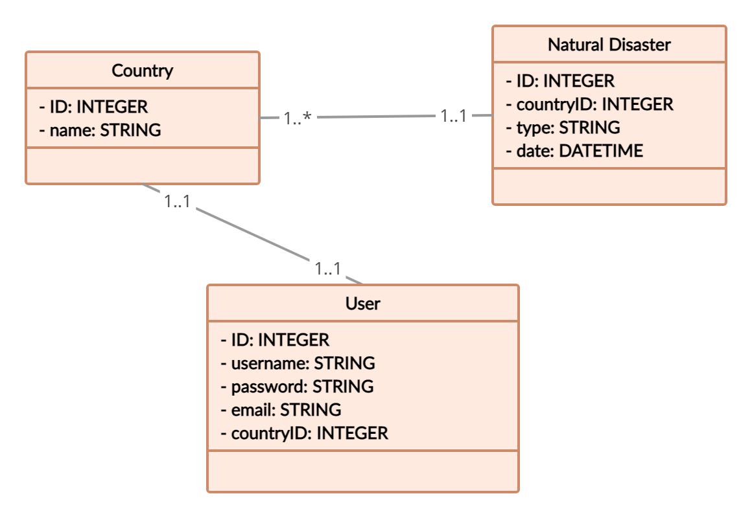
Class Diagram

Slide 19
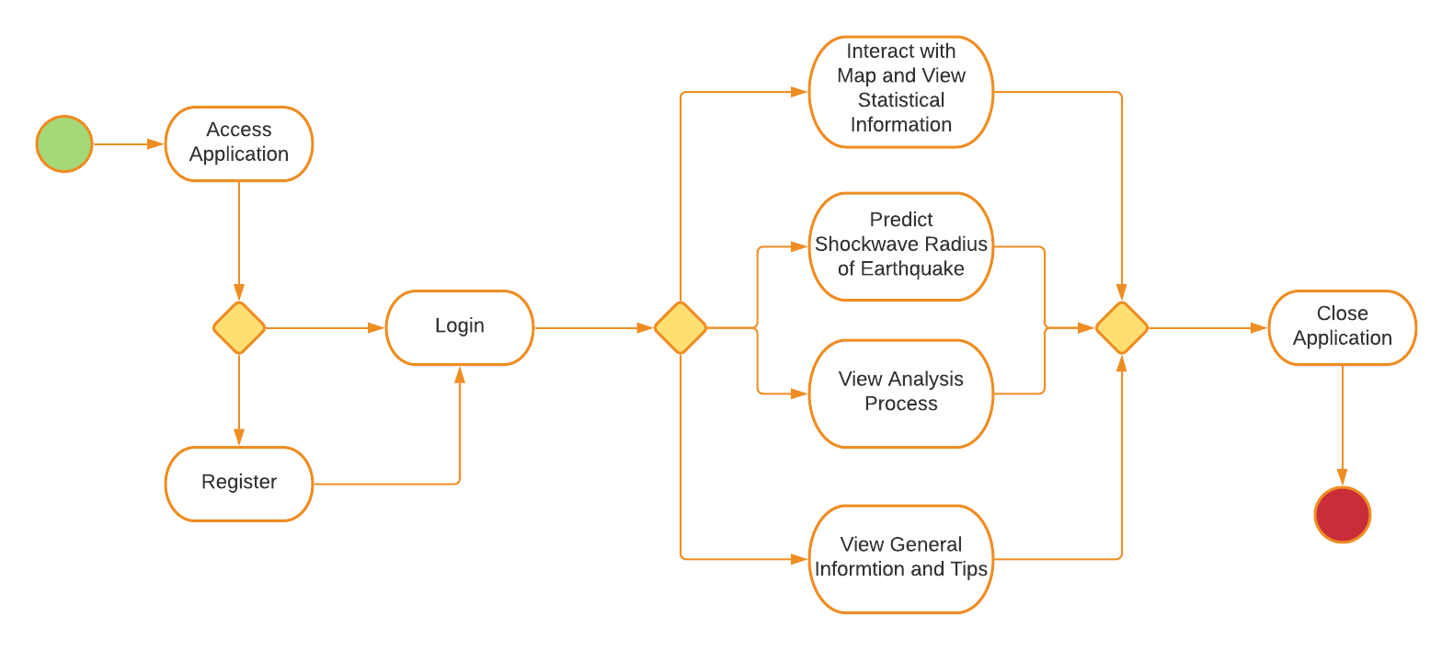
Business Process Model and Notation (BPMN)

Slide 20
Implementation

Slide 21

Sign In/Sign Up

Slide 22

Home

Slide 23
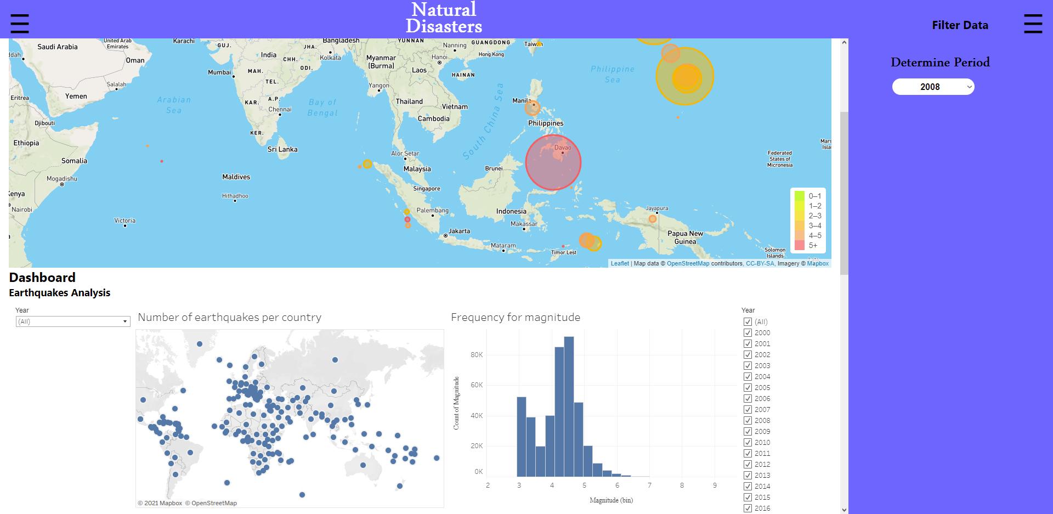
Interactive Map and Dashboards

Slide 24
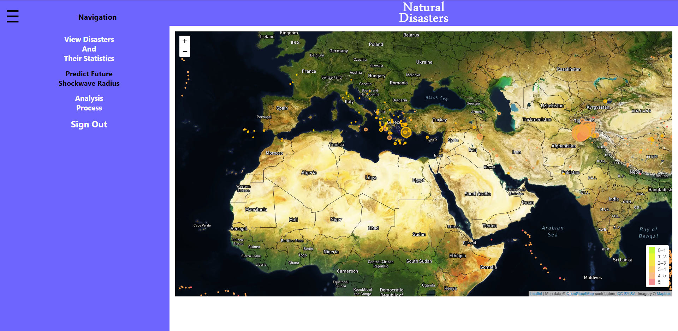
Prediction

Slide 25
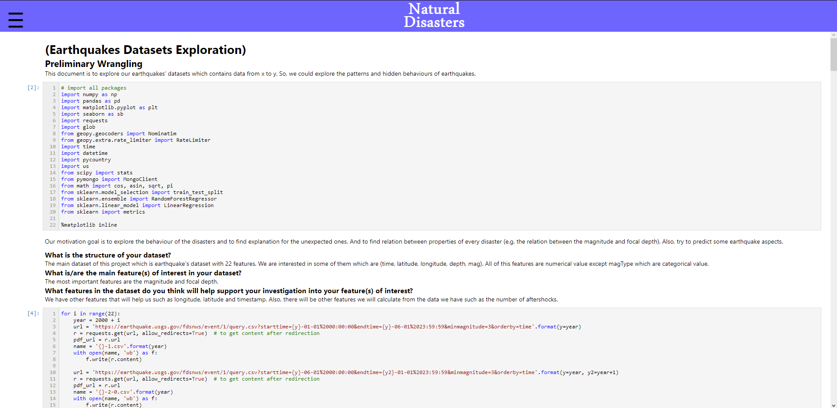
Analysis Process

Slide 26
Trial and Demo

Slide 27
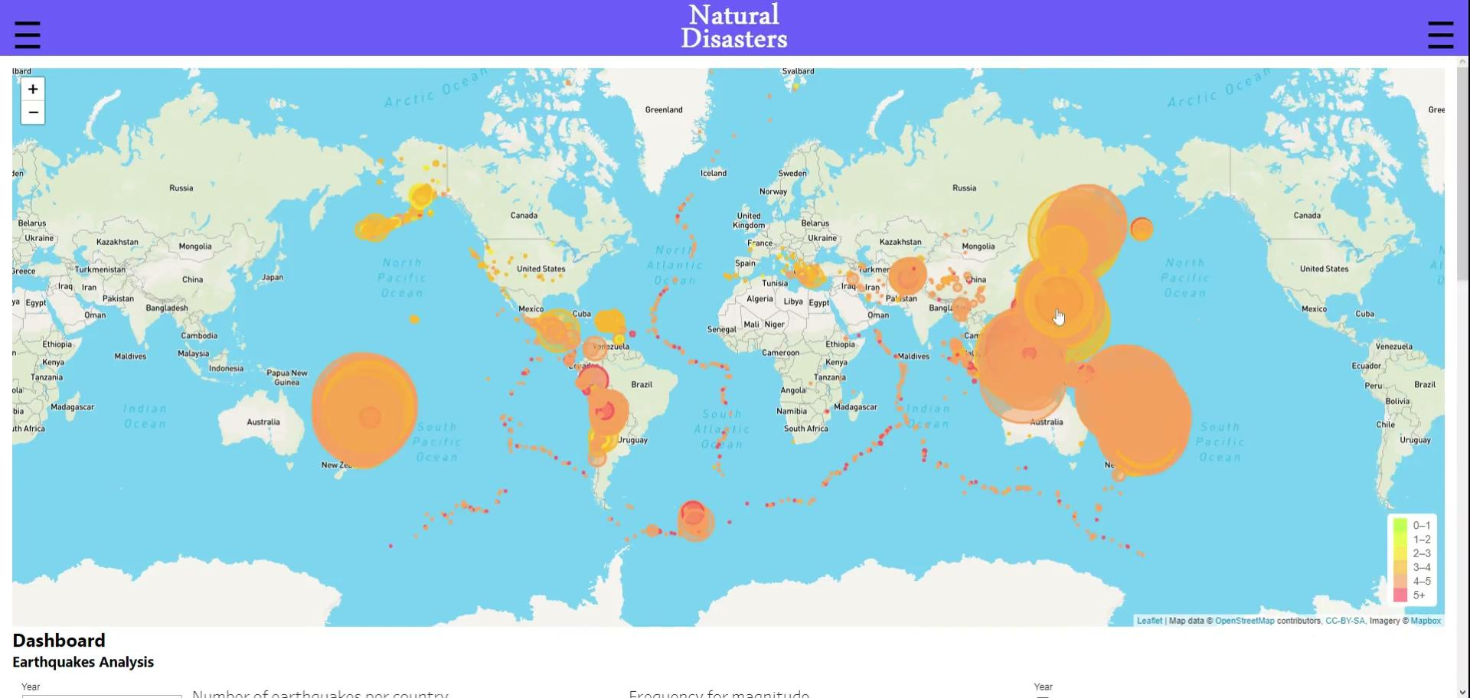
Video Demo

Slide 28

QR-Code

Slide 29
Project Evaluation

Slide 30
Wrangling Process
Data cleaning.
Data analysis.

Slide 31
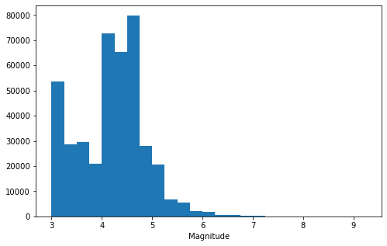
Frequency of magnitude

Slide 32
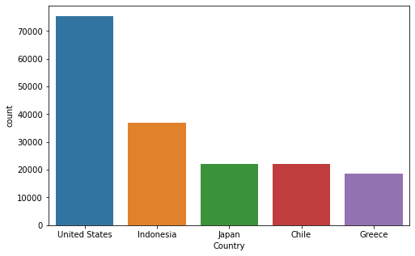
Top 5 countries

Slide 33
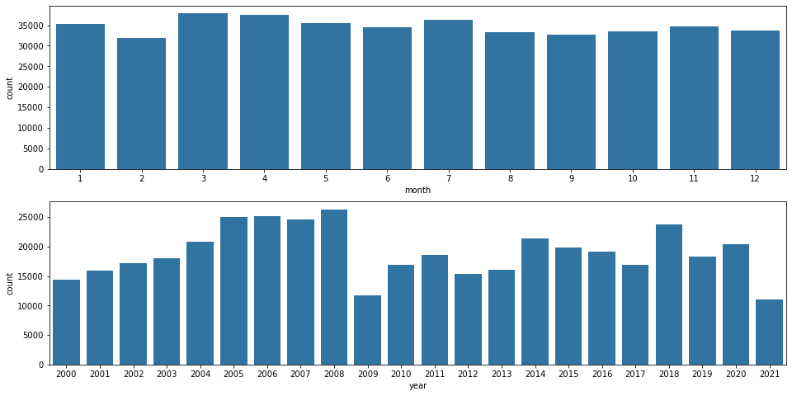
Earthquakes per year and month

Slide 34
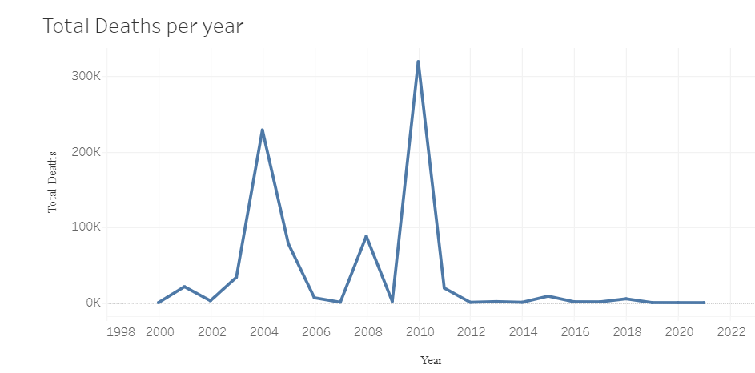

Slide 35
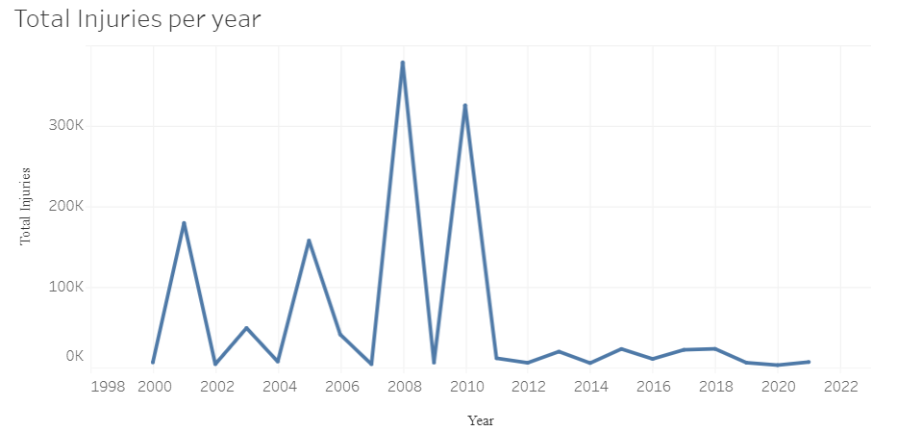

Slide 36
Prediction Process
Models used.
Accuracy achieved.

Slide 37
Project Timeline

Slide 38
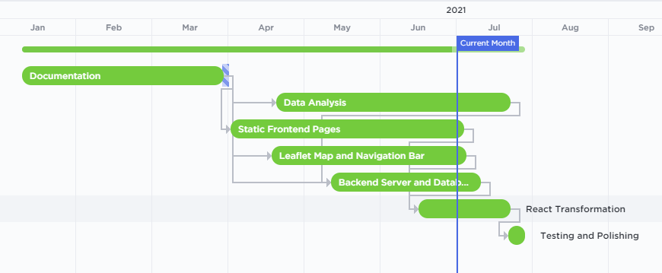
Gantt Chart

Slide 39
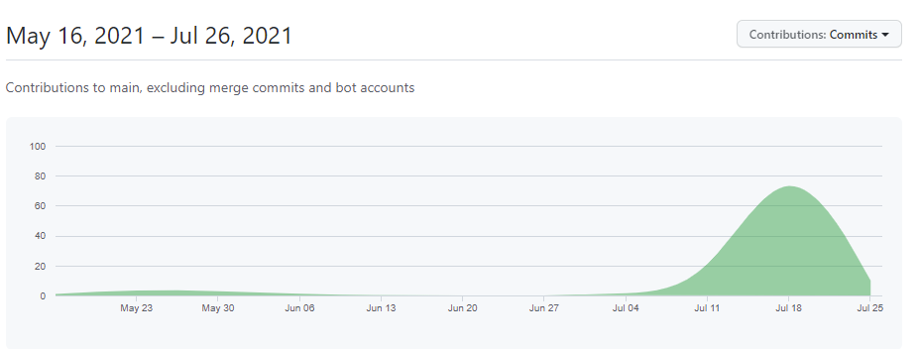
Github Commits

Slide 40
Conclusion and Future Work

Slide 41
Conclusion
Main points
Significance of the results

Slide 42
Future Work
More data can be systematically inserted into the database.
Add other Natural Disaster types to the system.
Make the Application responsive for mobile devices usage.
Try to enhance our prediction accuracy

Slide 43
https://www.seowebsitedesign.com/the-waterfall-model-of-software-development/
https://www.seowebsitedesign.com/the-waterfall-model-of-software-development/
https://www.ngdc.noaa.gov/hazel/view/about
https://earthquake.usgs.gov
https://www.adobe.com/mena_en/products/xd.html
https://app.creately.com/diagram/
https://mongoosejs.com/docs/guide.html
https://docs.mongodb.com
https://leafletjs.com
https://react-leaflet.js.org
https://reactjs.org
https://blog.jumpstartinsurance.com/can-aftershocks-be-predicted/
References

Slide 44
Thank you!

Slide 45
Questions?

